Slide 1
Office Camp
September 2014

Slide 2
Course Agenda
Office Camp
Module 1: Introduction to the Day
Module 2: Setting up the Environments
Module 3: Hooking into Apps for SharePoint
Module 4: Hooking into Office 365 and SharePoint APIs with SPAs
Module 5: Hooking into Apps for Office

Slide 3
Hooking into Apps for SharePoint
Speaker
Speaker

Slide 4

Agenda
Introduction
Programming OAuth
Programming Cross-Domain Library

Slide 5
Introduction

Slide 6

Architecture
SQL Azure
Azure Web Sites
Remote Web
Azure Data Market
Host Web
SharePoint Online
App Web¹
¹App Web is optional
Notes:
Remote web is deployed on separate infrastructure
Typically this is Azure web sites, but can be anything
Solution may or may not have an App Web depending upon whether anything is deployed (like lists or libraries in the App Web)
Host web can be accessed by remote web using OAuth or cross-domain library
Additional assets like SQL Azure or web-based REST services can be accessed from the remote web and incorporated into the solution

Slide 7
App Permissions
Remote web always has full rights to app web
App permissions are the lesser of user and app permissions to the given resource
Provider-hosted app can utilize “app-only” permissions to “elevate” privileges.

Slide 8
App-Only Permissions
Considers app permissions only, ignores user
Set AllowAppOnlyPolicy to true in AppManifest
Get an app-only token
Notes:
Provider-hosted apps can use “app only” permissions
Update the App manifest to indicate this is OK
Then you need an app-only token in code

Slide 9
Creating Provider-Hosted Apps
Web Project
ASP.NET Web Forms
MVC 5
Authorization
Azure Access Control Services
Server-to-Server High Trust
Programmability
SharePointContextProvider class
Managed CSOM or REST
JavaScript Cross-Domain Library
Notes:
Visual Studio supports both ASP.NET Web Forms and MVC5
On-premises authorization uses S2S
Cloud authorization uses OAuth
The SharePointContextProvider simplifies token management
Managed CSOm and RESt can be used directly from the server side
The cross-domain library can be used from JavaScript

Slide 10
Programming OAuth

Slide 11
What is OAuth 2.0?
Simple mechanism to grant a third party access to a user’s resources without sharing the user’s password.
Cross platform app authorization
Internet Standard supported by Azure, Facebook, Google, Twitter, and more
Notes:
OAuth provides a simple mechanism for end-users to grant a third party access to their data and resources without sharing their passwords.
It also enables the user to grant access limited by scope and duration.

Slide 12
OAuth 2.0 Tokens
Context Token
Information about the Resources Owner and Client that can be used to get an Access Token later.
Refresh Token
A token used to get an Access Token from the Authorization Server.
Access Token
A token passed to the Resource Server authorizing the Client to access resources.
Authorization Code
A code that can be used to register an app on-the-fly.
Notes:
In the OAuth 2.0 model, access to protected resources is done using access tokens —an object with a specific scope, lifetime, and other access attributes. OAuth access tokens are sometimes compared to valet keys. In the same way as a valet key gives restricted access to a car, allowing a valet to drive it but not open the trunk or the glove compartment, the access token allows a client application restricted access to a user’s data at a resource server via tokens issued by an authorization server in response to the user authorizing access.
With OAuth 2.0, a third-party application does not use the resource owner's credentials to access protected resources. Instead, the third-party application obtains an access token. Access tokens are issued to third-party clients by an authorization server with the approval of the resource owner. The client uses the access token to access the protected resources hosted by the resource server.

Slide 13
App Principals
Apps must be registered with SharePoint online
Client ID – generated during the registration process
Client Secret – generated during the registration process
App Host Domain – the domain of the Azure web site hosting the app
Redirect URL – the URL of the return page after permissions are granted
SharePoint provides registration management pages
AppRegNew.aspx – for registering a new app
AppInv.aspx – for updating registered apps
AppPrincipals.aspx – lists all registered apps
Notes:
Apps are first-class principals in SharePoint
They have an identifier and permissions, which are tracked in SharePoint through the registration and installation process

Slide 14
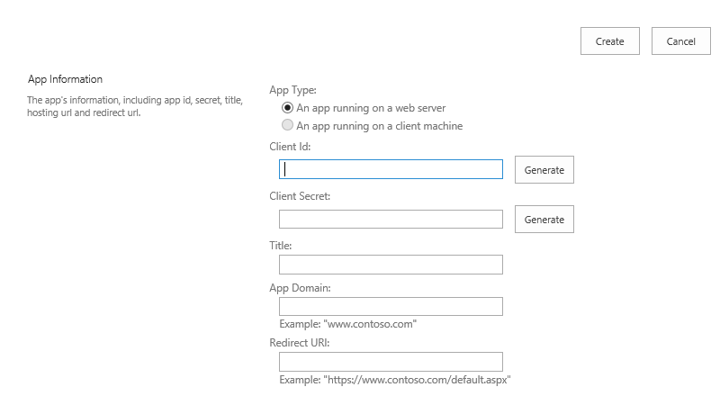
Registering a New App
Generated value
Generated value
Free text value
Azure domain (e.g., myapp.azurewebsites.net)
Web address (e.g., https://myapp.azurewebsites.net)
Notes:
Apps must be registered with SharePoint. This page will generate a new client ID and secret for the app. If deployed to Azure, use that information to fill out the rest of the form.

Slide 15
Provider-Hosted App Flow Scenario
User has Organizational Account
App registered with SharePoint Online
App deployed to SharePoint Online
Remote Web deployed as an Azure Website
Client ID and Client Secret defined in AAD

Slide 16



OAuth 2.0 Flow Provider-Hosted App
Azure Web Site
(Client)
End User
(Resource Owner)
Azure ACS
(Authorization Server)
SharePoint Online
(Resource Server)

Slide 17
OAuth 2.0 Flow Provider-Hosted App
Azure Web Site
(Client)
End User
(Resource Owner)
User launches app
Azure ACS
(Authorization Server)
SharePoint Online
(Resource Server)

Slide 18
OAuth 2.0 Flow Provider-Hosted App
Azure Web Site
(Client)
End User
(Resource Owner)
Request Context token
for user
Azure ACS
(Authorization Server)
SharePoint Online
(Resource Server)

Slide 19
OAuth 2.0 Flow Provider-Hosted App
Azure Web Site
(Client)
End User
(Resource Owner)
Context Token returned
Azure ACS
(Authorization Server)
SharePoint Online
(Resource Server)

Slide 20
OAuth 2.0 Flow Provider-Hosted App
Azure Web Site
(Client)
Context Token returned
and user redirected to app
End User
(Resource Owner)
Azure ACS
(Authorization Server)
SharePoint Online
(Resource Server)

Slide 21
OAuth 2.0 Flow Provider-Hosted App
Azure Web Site
(Client)
End User
(Resource Owner)
App extracts Refresh Token
from Context Token
Azure ACS
(Authorization Server)
SharePoint Online
(Resource Server)

Slide 22
OAuth 2.0 Flow Provider-Hosted App
Azure Web Site
(Client)
App requests Access Token
using refresh Token
End User
(Resource Owner)
Azure ACS
(Authorization Server)
SharePoint Online
(Resource Server)

Slide 23
OAuth 2.0 Flow Provider-Hosted App
Azure Web Site
(Client)
Access Token returned
End User
(Resource Owner)
Azure ACS
(Authorization Server)
SharePoint Online
(Resource Server)

Slide 24
OAuth 2.0 Flow Provider-Hosted App
Azure Web Site
(Client)
End User
(Resource Owner)
Access Token presented
Along with request
Azure ACS
(Authorization Server)
SharePoint Online
(Resource Server)

Slide 25
OAuth 2.0 Flow Provider-Hosted App
Azure Web Site
(Client)
End User
(Resource Owner)
Response returned
Azure ACS
(Authorization Server)
SharePoint Online
(Resource Server)

Slide 26
SharePointContextProvider Class
Checks for valid Context Token
Redirects if it does not exist
Simplifies the management of context
Provides an ACS or STS context
Context exposes properties for key values like Host Web URL
Simplifies the management of tokens
Context exposes methods to retrieve tokens
Notes:
The SharePointContextProvider simplifies the management of context, and tokens
It uses a cookie to store the CacheKey, and stores the actual token in session state on the server referenced by the cache key
All of this improves performance and makes programming easier

Slide 27
SharePointAcsContext Class
Inherits SharePointContext
Provides specific properties and methods for dealing with context and access tokens
CSOM
CreateAppOnlyClientContextForSPAppWeb
CreateAppOnlyClientContextForSPHost
CreateUserClientContextForSPAppWeb
CreateUserClientContextForSPHost
REST
AppOnlyAccessTokenForSPAppWeb
AppOnlyAccessTokenForSPHost
UserAccessTokenForSPAppWeb
UserAccessTokenForSPHost
Notes:
Abstracts the management of tokens to make it easier

Slide 28
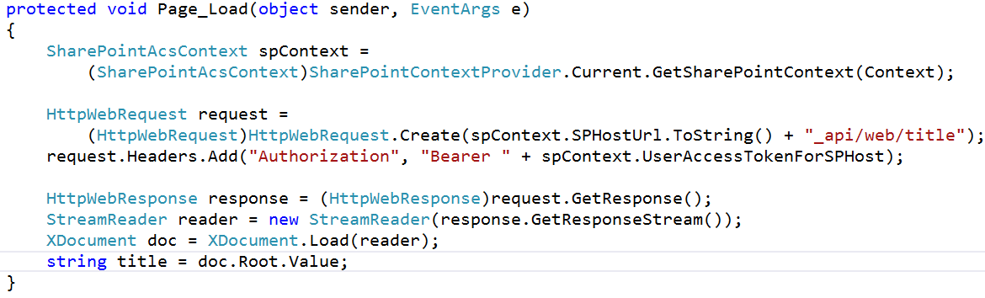
Making REST Calls with OAuth

Slide 29
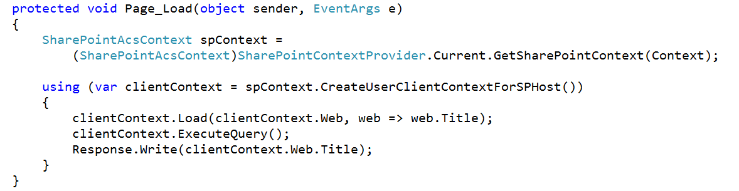
Making CSOM Calls with OAuth

Slide 30
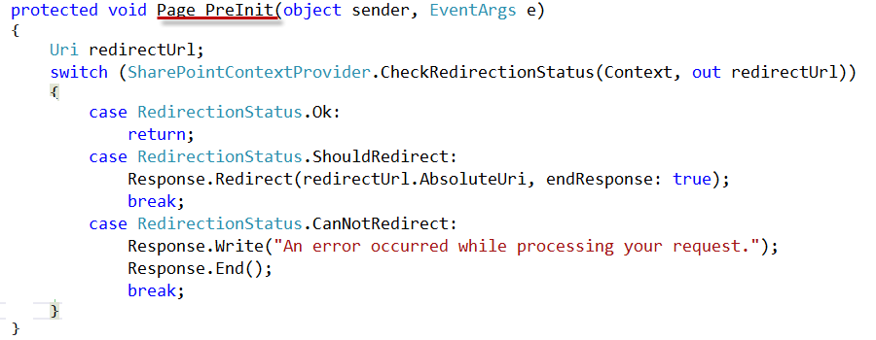
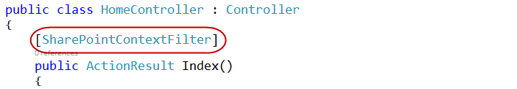
Validating Context Token
Web Forms
MVC 5
Notes:
ASP.NET Web Forms uses the PreInit method to validate the Context Token
Notice how it will redirect if the token is not valid
ASP.NET MVC 5 uses a filter to run essentially the same code
Notice how the filter attribute is applied to the controller

Slide 31
Managing SharePoint Context
SharePointContextProvider GetSharePointContext
Returns SharePointAcsContext in cloud
Returns SharePointHighTrustContext on premises
Properties
SPAppWebUrl
SPClientTag
SPHostUrl
SPLanguage
SPProductNumber
Notes:
SharePointAcsContext and SharePointHightTrustContext both inherit from SharePointContext
This means that the same code works in both cloud and on-premises environments

Slide 32
Managing Security Tokens
CSOM
CreateAppOnlyClientContextForSPAppWeb
CreateAppOnlyClientContextForSPHost
CreateUserClientContextForSPAppWeb
CreateUserClientContextForSPHost
REST
AppOnlyAccessTokenForSPAppWeb
AppOnlyAccessTokenForSPHost
UserAccessTokenForSPAppWeb
UserAccessTokenForSPHost
Notes:
The SharePointContext makes it easy to get the tokens you need

Slide 33
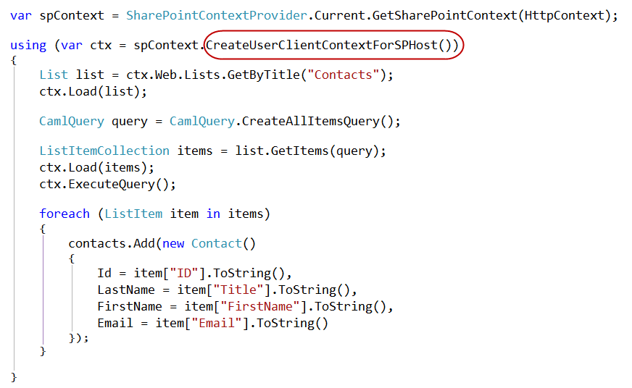
Managed CSOM

Slide 34
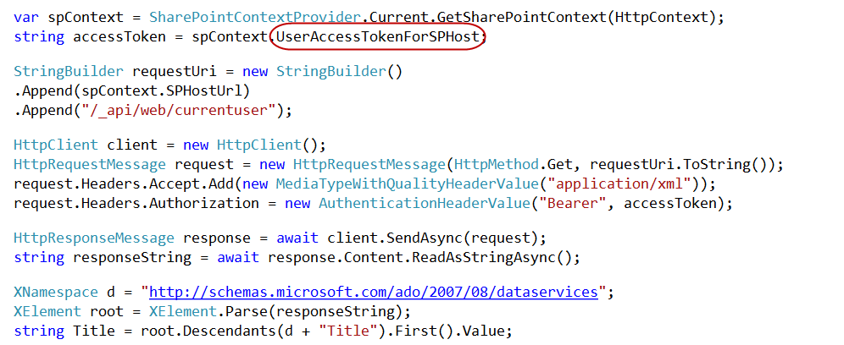
Managed REST

Slide 35
demo
Creating an App Part with a Provider-Hosted App

Slide 36
Programming Cross-Domain Library

Slide 37
Managing SharePoint Context
SPContext.js Library part of project template
Appends SPHostUrl as query string to all the links which point to current domain
Notes:
This is an optional component
You could also use HTML5 to build your own cache
But you really need to save the standard tokens because you will need them on other pages in the app
That’s the basic problem: you need the standard tokens in many places, so you can cache them or pass them along

Slide 38
Cross Domain Library
Same-domain policy prevents JavaScript from making direct calls to either the app web or host web from the remote web
Required to make JavaScript calls to both the app web and host web
Notes:
Makes it possible to call the app web or host web from JavaScript in the remote web

Slide 39
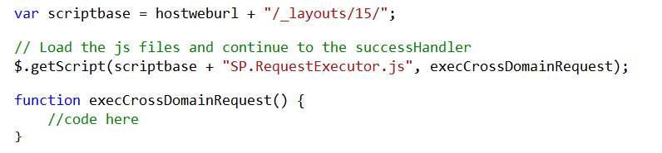
Loading the Cross-Domain Library
SP.RequestExecutor.js located in LAYOUTS directory
Option 1: Copy and include directly in your app
Option 2: Load Dynamically using jQuery

Slide 40
Cross-Domain Library Architecture
Web Page
IFRAME
App Web
AppWebProxy.aspx
SP.RequestExecutor.js
AppWebProxy.aspx
Remote Web
SharePoint
Notes:
The remote web loads the SPRequestExecutor.js library
The remote web create a new SP.RequestExecutor object, initializing it with the URL of the app web
This causes a hidden IFRAME to be created, which loads APPWebProxy.aspx from the LAYOUTS directory
The SP.RequestExecutor object uses the HTML5 postmessage command to send requests from the remote web
The request is executed by the AppWebProxy.aspx page
The response is returned

Slide 41
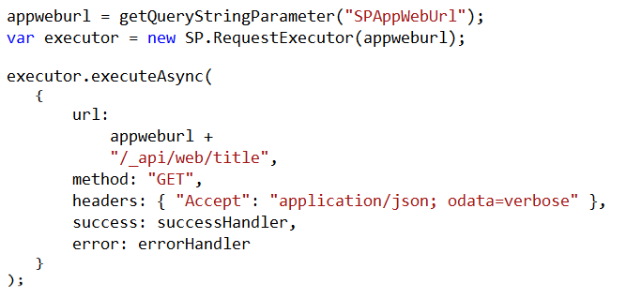
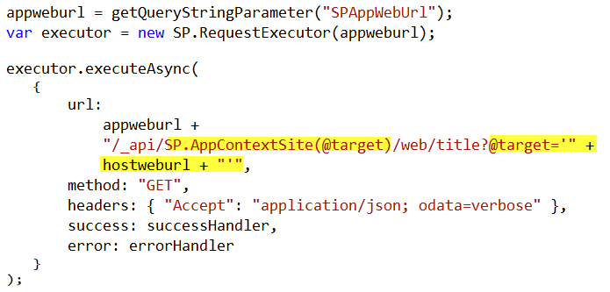
Cross-Domain REST Calls
Call targeting App Web
Call targeting Host Web
Notes:
When calling the host web, you must switch the context

Slide 42
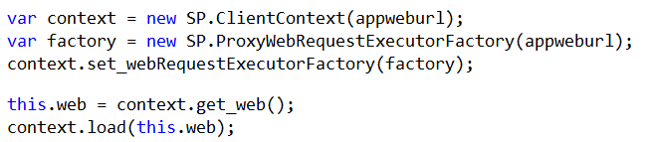
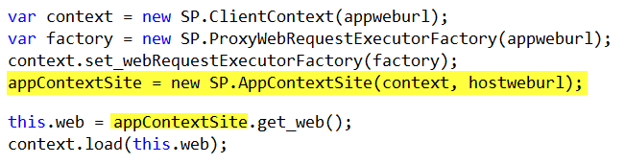
Cross-Domain CSOM Calls
Call targeting App Web
Call targeting Host Web
Notes:
When calling the host web, you must switch the context

Slide 43
demo
The Cross-Domain Library

Slide 44
Summary
Introduction
Programming OAuth
Programming Cross-Domain Library

Slide 45

© 2012 Microsoft Corporation. All rights reserved. Microsoft, Windows, and other product names are or may be registered trademarks and/or trademarks in the U.S. and/or other countries.
The information herein is for informational purposes only and represents the current view of Microsoft Corporation as of the date of this presentation. Because Microsoft must respond to changing market conditions, it should not be interpreted to be a commitment on the part of Microsoft, and Microsoft cannot guarantee the accuracy of any information provided after the date of this presentation. MICROSOFT MAKES NO WARRANTIES, EXPRESS, IMPLIED OR STATUTORY, AS TO THE INFORMATION IN THIS PRESENTATION.

